Slide 1

SecureComment: Safeguarding Online Discussions with Intelligent Toxic Comment Filtering
Team Number :
AM.EN.U4CSE20072 : Tekula Samhitha
AM.EN.U4CSE20238 : K Naveen Kumar
AM.EN.U4CSE20261 : R Reddy Kowshik
AM.EN.U4CSE20270 : V Subhash Kovid
CA7
Amrita School of Computing | Amrita Vishwa Vidyapeetham | Amritapuri

Slide 2
Introduction
In today's digital age, online communication platforms are increasingly pivotal, emphasizing the urgent need for a secure and respectful online environment.
Toxic comments, hate speech, and harassment on online platforms can create hostile environments, posing potential harm to users.
Developing effective filtration systems is crucial to combat negative impacts, fostering civil discourse and making online spaces more inclusive.
Toxic comment filters leverage cutting-edge technologies like natural language processing and machine learning.
These filters play a pivotal role in removing harmful content, contributing to a safer and more respectful digital environment.
The project presents an opportunity to innovate and utilize advanced technologies for creating solutions that enhance online safety and encourage constructive conversations.

Slide 3
Motivation
The motivation for developing a secure comment web application with toxic comment filtration stems from a range of compelling reasons, driven by the pressing need to enhance online interactions and user experiences. Here are some key motivations for this project:
The prominence of unpleasant and dangerous information stifles good involvement produces a hostile environment and endangers user safety.
Comment Toxicity Filter allows users to tailor their experience to their preferences.
Filtering toxic content is crucial as comment toxicity can lead to severe consequences, including emotional distress, mental health issues, and even self-harm among targeted individuals.

Slide 4
Persisting Challenges
Challenges Identified:
Dynamic Language: Toxic language evolves rapidly.
Context and Intent: Accurate detection requires understanding.
Data Quality and Bias: Ensuring diverse, unbiased training data.
Challenges Addressed in this Project
Dynamic Language:
Regular model updates to adapt to evolving toxic language.
Context and Intent:
Developing a model that recognizes context and intent nuances.
Data Quality and Bias:
Ensuring diverse, balanced training data for ethical comment classification.

Slide 5
Background Study/Related Work
Title & Year | Problems | Contributions | Limitations | Open problems/Future work
Rahul, Harsh Kajla, Jatin Hooda, and Gajanand Saini. "Classification of online toxic comments using machine learning algorithms." 2020 4th international conference on intelligent computing and control systems (ICICCS). IEEE, Paper – 1 | Paper focuses on classifying toxic online comments with machine learning. Toxic comments impede free expression, leading platforms to restrict or close comments. Study aims to assess online harassment extent and propose a viable classification solution. | Paper systematically analyzes online comment toxicity with six machine learning algorithms. Compares algorithms using metrics such as hamming loss, accuracy, and log loss. Identifies logistic regression as the best-performing model, balancing high accuracy with low hamming loss. | Paper doesn't explicitly mention limitations; potential constraints encompass data, generalizability, scalability, bias, and model robustness. Addressing these concerns can boost the reliability and applicability of the proposed approach. | Future research could explore alternative machine learning models such as LSTM, multi-layer perceptron, and GRU for improved results. Addressing imbalanced data, ensuring fairness, and considering real-world implementation are crucial aspects for further investigation and enhancement.
Mullah, Nanlir Sallau, and Wan Mohd Nazmee Wan Zainon. "Advances in machine learning algorithms for hate speech detection in social media: a review.“ | Paper focuses on hate speech detection in social media, treating it as a text classification task. Challenges highlighted encompass dataset availability, data sparsity, imbalanced datasets, cultural variation, and the impact of pandemic or | Paper aims to inform readers about critical steps in hate speech detection with machine learning. Evaluates strengths and weaknesses of different methods, guiding researchers in algorithm selection. | The main limitation of the study is that no experiments were conducted with a given dataset. Instead, the work of other researchers was critically appraised and synthesized | Paper identifies open challenges in hate speech detection: cultural variations, data sparsity, imbalanced datasets, and considering the impact of events like pandemics or natural disasters. Review suggests exploring hate speech

Slide 6
Background Study/Related Work
IEEE Access 9 (2021): 88364-88376. Paper - 2 | natural disasters. | Review covers various variants of machine learning |  | detection with ensemble and deep learning methods.
Rodriguez, Axel, Carlos Argueta, and Yi-Ling Chen. "Automatic detection of hate speech on facebook using sentiment and emotion analysis." 2019 international conference on artificial intelligence in information and communication (ICAIIC). IEEE, 2019. Paper - 3 | Hate speech is rampant on Facebook, posing a major concern. Identifying highly discussed hate speech topics is challenging due to concealed intentions in posts. The need to address this issue is pressing. | Proposed a new framework using graph, sentiment, and emotion analysis for hate speech detection. Identifies pages potentially promoting hate speech by analyzing negative posts and comments. Leverages K-means clustering to identify sensitive topics with promising results. | Framework concentrates on analyzing public posts, potentially overlooking hate speech in private or closed groups. Effectiveness may vary based on seed pages and parameter choices. Detection of subtle or coded hate speech poses a challenge for the framework. | Future work involves incorporating the latest comments and replies to capture complete conversations. Testing more parameter combinations with diverse seed pages to evaluate effectiveness. Enhancing accuracy in detecting subtle hate speech and exploring regional variations are essential for progress.
Abro, Sindhu, et al. "Automatic hate speech detection using machine learning: A comparative study." International Journal of Advanced Computer Science and Applications 11.8 (2020). | Increasing social media use has led to a surge in hate speech, posing challenges for content moderation and fostering online hostility. Study addresses the issue using machine learning for automatic hate speech detection. | Paper contributes by comparing Bigram with TFIDF, word2vec, and doc2vec for hate speech detection feature engineering. Evaluates eight machine learning algorithms (SVM, RF, LR, NB, KNN, DT, AdaBoost, and MLP) | Study acknowledges limitations: inefficient real-time prediction accuracy affecting live content. Model limited to three hate speech classes, lacking severity identification for nuanced cases. | Improve real-time prediction accuracy and develop a sophisticated model to assess hate speech severity. Enhance using lexicon-based techniques and gather more data for effective training.

Slide 7
Background Study/Related Work
Paper - 4 | Compares performance of various feature engineering techniques and machine learning algorithms. | Presents experimental results and insights, enhancing understanding of hate speech detection techniques. |  | Research and compare model performance with state-of-the-art hate speech detection methods.
Istaiteh, Othman, Razan Al-Omoush, and Sara Tedmori. "Racist and sexist hate speech detection: Literature review." 2020 international conference on intelligent data science technologies and applications (IDSTA). IEEE, 2020. Paper - 5 | Paper tackles the pressing issue of increasing racist and sexist hate speech fueled by internet and social media. Main challenge is developing effective hate speech detection models for safer platforms without compromising freedom of speech principles. | Paper offers a thorough survey on detecting racist and sexist hate speech, focusing on datasets, features, and machine learning models. Identifies challenges like limited annotated data, dialect impact on annotations, and lack of generalizability to other social media platforms. | Scarcity of annotated datasets hinders accurate and robust model training. Outdated feature representations, such as word n-grams and char n-grams, prove less effective in hate speech detection. Word2Vec and Doc2Vec face challenges with out-of-vocabulary words and short tweets. | Lack of professionally annotated datasets hampers hate speech detection model performance. Future research should explore LSTM-based deep learning feature extraction and ensemble learning to enhance results. Emphasize developing models that generalize across diverse social media platforms beyond Twitter.

Slide 8
Project Contributions
Contributions of the Project:
Comparative Analysis of Machine Learning Algorithms for Toxic Comment Detection.
Optimized Feature Representation and Selection Techniques.
Objectives:
Perform feature engineering and selection.
Implement and compare traditional machine learning algorithms.
Experiment with ensemble techniques for improved classification.
Outcomes/Deliverables:
To this end, we propose a tool which serves as a precaution, minimising the exposure of abusive remarks and fostering a more constructive atmosphere for all users.
Comparative Analysis of Machine Learning Algorithms.
Assumptions:
Fairness and bias considerations in model predictions.
Handling class imbalance.
Ethical deployment for responsible content moderation and user freedom of expression.

Slide 9
Improvements Based on First Review(If any)
The reviewers offered valuable suggestions to improve the project:
Enhance Background Study Table:
Simplified the table for better visual clarity.
Presented information concisely using bullet points to avoid overcrowding.
Code Review Improvements:
Integrated essential elements such as the confusion matrix, AUC, ROC curves, and log loss methods into the code for a more comprehensive evaluation.
Ensured these additions contribute to a thorough analysis of the project.
Incorporate Thorough Evaluation Metrics:
Included key evaluation metrics to provide a comprehensive understanding of the project's past performance.
Addressed the reviewers' suggestion to enhance the depth of the evaluation for a more robust assessment

Slide 10
Progress After First Review
Explored Different Models:
Tried out four additional models: linear regression, random forest, ensemble model with voting classifier, and ensemble model with stacking classifier.
Comparison of Models:
Evaluated and compared the performance of these models using evaluation metrics like accuracy, F1 score, precision and recall seeing how well each one works.
Implementation of Evaluation Metrics:
Added various ways to measure how good the models are, such as confusion matrix, AUC, ROC curves, and log loss, into the code.

Slide 11
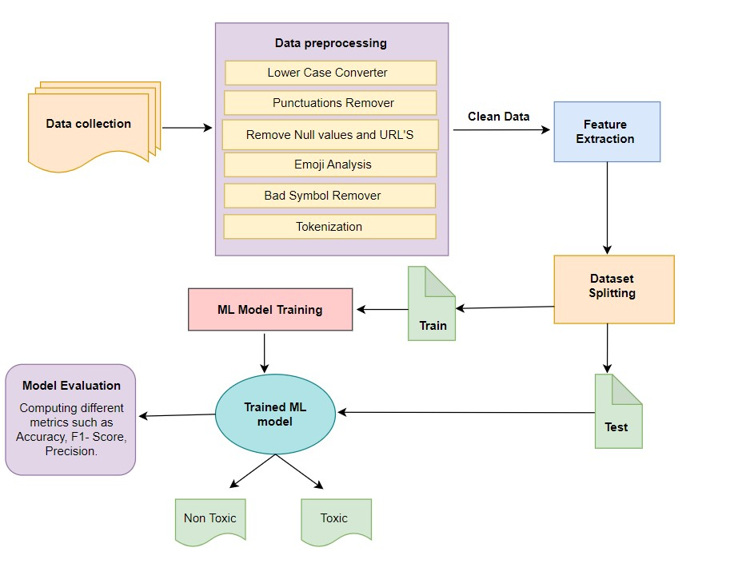
High Level Design

Slide 12
Algorithms
Algorithm 1: Random Forest Classifier
Toxic comments often exhibit intricate patterns and context. The Random Forest algorithm's ensemble of decision trees allows us to capture these nuances.
By aggregating the predictions of multiple decision trees, we enhance the model's accuracy and mitigate the risk of overfitting.
Algorithm 2: Support Vector Machine (SVM)
Toxic comment detection involves distinguishing between toxic and non-toxic comments, a classic binary classification problem.
SVM's ability to find the optimal hyperplane that maximizes the margin between classes ensures robust classification, especially when dealing with nonlinear data.

Slide 13
Algorithms
Algorithm 3: Logistic Regression
Logistic Regression in our code serves as a foundational model, revealing linear relationships to establish feature importance in binary classification tasks.
This algorithm provides insights into the contribution of each feature, aiding in understanding toxicity indicators.
Algorithm 4: K-Nearest Neighbors (KNN)
The K-Nearest Neighbors algorithm, applied in our code, identifies toxicity clusters in localized regions.
This approach is beneficial when toxic comments exhibit specific spatial patterns, allowing the model to capture local nuances for improved performance.

Slide 14
Algorithms
Algorithm 5: Voting Classifier
The Voting Classifier in our code combines predictions from diverse models, including SVC, Logistic Regression, and Random Forest.
This ensemble approach aims to achieve a more robust and balanced toxic comment classification by leveraging the strengths of multiple algorithms.
Algorithm 6: Stacking Classifier
Our Stacking Classifier introduces a meta-model that combines predictions from base models (Random Forest, KNN, SVC, Logistic Regression).
This stacking approach enhances adaptability to intricate toxicity patterns, contributing to a comprehensive toxic comment detection framework.

Slide 15
Experimental Setup
We have used twitter dataset.
Types of Experiments
Algorithm Selection: Explored a diverse set of machine learning algorithms, including Random Forest, Support Vector Classifier, Logistic Regression, K-Nearest Neighbors, Voting Classifier, and Stacking Classifier.
Feature Extraction Techniques: Utilized Count Vectorization and TF-IDF Vectorization for converting text data into numerical format, capturing essential features for toxicity classification.
The Evaluation Metrics Used
Performance Metrics: Evaluated algorithms using precision, recall, and F1 score to measure their effectiveness in distinguishing toxic and non-toxic comments.
Additional Metrics: Analyzed accuracy, log loss, and receiver operating characteristic (ROC) curves to gain comprehensive insights into algorithm performance.

Slide 16
Experiments and Results
Metric | SVC | Random Forest | Logistic Regression | K-Nearest Neighbors | Voting Classifier | Stacking Classifier
Precision | 0.77 | 1.00 | 0.87 | 0.75 | 0.90 | 0.89
Recall | 0.51 | 0.19 | 0.41 | 0.03 | 0.38 | 0.52
F1 Score | 0.62 | 0.32 | 0.56 | 0.06 | 0.54 | 0.66

Slide 17
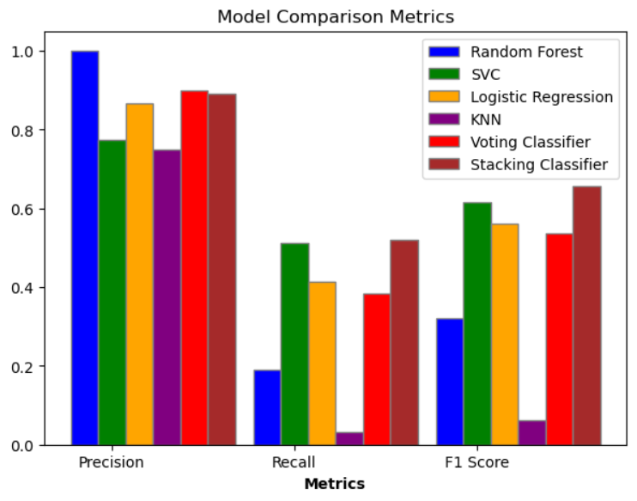
Experiments and Results

Slide 18
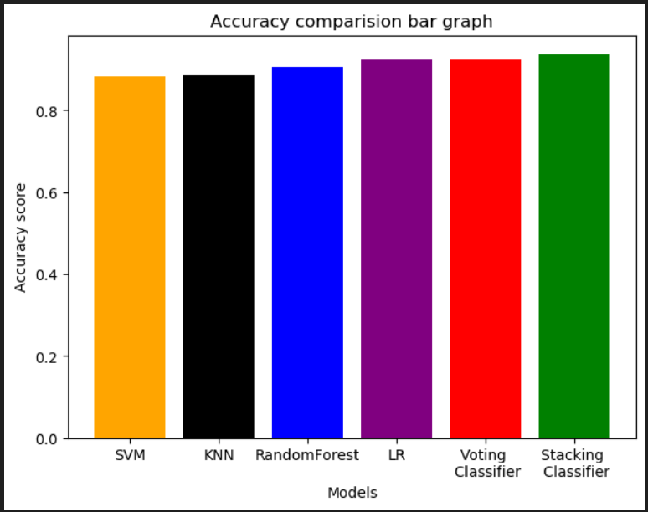
Experiments and Results

Slide 19
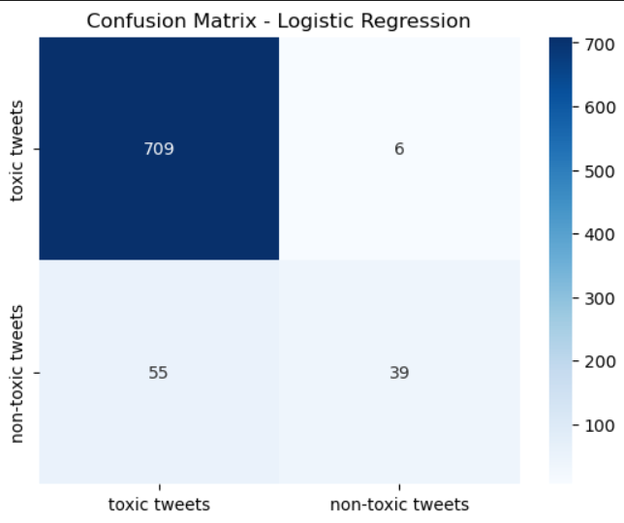
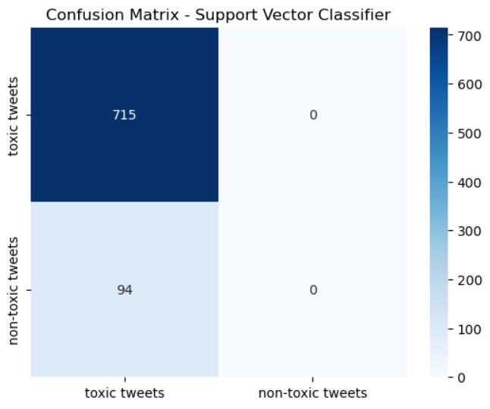
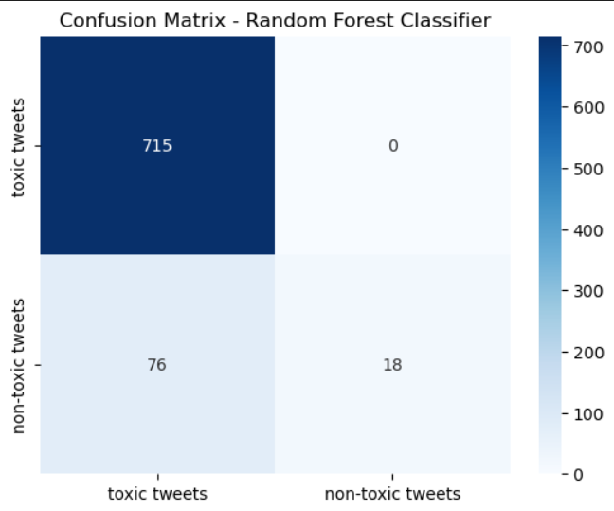
Experiments and Results

Slide 20


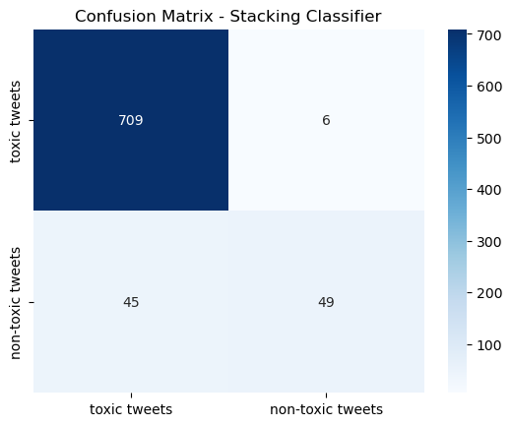
Experiments and Results

Slide 21
Findings
Findings and Inferences
Random Forest Classifier:
Captures intricate patterns in toxic comments.
Ensembles decision trees for enhanced accuracy and reduced overfitting.
Support Vector Machine (SVM):
Effective for binary classification, distinguishing toxic from non-toxic comments.
Utilizes an optimal hyperplane to maximize the margin between classes.
Logistic Regression:
Applied for its simplicity and efficiency in binary classification.
Suitable for analyzing the relationship between features and the binary outcome.
K-Nearest Neighbors (KNN):
Utilized for simplicity and effectiveness in classifying data points based on neighbors.
Requires no training phase, making it computationally efficient.

Slide 22
Findings
Voting Classifier:
Ensemble of multiple classifiers (SVM, Logistic Regression, Random Forest).
Combines individual models for improved overall performance.
Stacking Classifier:
Employs multiple base models (Random Forest, KNN, SVM, Logistic Regression) and a meta-model.
Enhances predictive performance through a layered model architecture.
State the practical implications
Accuracy Comparison Bar Graph:
Compares accuracy, providing a visual representation of model performance.
Model Comparison Metrics:
Displays precision, recall, and F1 score for detailed model performance analysis.

Slide 23
Conclusion
Originality/Uniqueness of Your Project:
This project stands out in its comprehensive approach to toxic comment classification, incorporating a diverse set of machine learning algorithms.
The utilization of ensemble methods, such as Voting and Stacking Classifiers, showcases an innovative approach to enhancing classification accuracy.
Practical Implications of the Work:
The practical implications are significant, contributing to online content moderation and creating safer digital spaces.
The models developed exhibit practical usability in identifying and filtering toxic comments, aiding in the improvement of online discourse.

Slide 24
Conclusion
Current Limitations in the Work:
The models may encounter challenges in adapting to rapidly evolving language trends and emerging expressions, potentially impacting their real-time effectiveness.
Continuous monitoring and updates are essential to address the evolving landscape of online communication effectively.
Future Scope:
Future work could involve continuous model refinement to adapt to evolving online language patterns.
Exploration of deep learning techniques or transformer-based models may further enhance the project's capabilities.

Slide 25
References
[1] Rahul,Harsh K, Jatin H, and Gajanand S. "Classification of online toxic comments using machine learning algorithms." IEEE Xplore, https://ieeexplore.ieee.org/stamp/stamp.jsp?arnumber=9120939&tag=1
[2] Mullah, Nanlir Sallau, and Wan Mohd Nazmee Wan Zainon. "Advances in machine learning algorithms for hate speech detection in social media: a review." IEEE Xplore, https://ieeexplore.ieee.org/stamp/stamp.jsp?arnumber=9455353&tag=1
[3] Rodriguez, Axel, Carlos Argueta, and Yi-Ling Chen. "Automatic detection of hate speech on facebook using sentiment and emotion analysis." IEEE Xplore, https://ieeexplore.ieee.org/stamp/stamp.jsp?arnumber=8669073
[4] Sindhu A, Zahid H, Sarang S, Zafar. "Automatic hate speech detection using machine learning: A comparative study." ResearchGate, https://www.researchgate.net/publication/344018753_Automatic_Hate_Speech_Detection_using_Machine_Learning_A_Comparative_Study
[5] Istaiteh Othman, Razan Al-Omoush, and Sara Tedmori. "Racist and sexist hate speech detection: Literature review." IEEE Xplore, https://ieeexplore.ieee.org/document/9264052?denied=

Slide 26
Thank You

